Slide 1
The Learning Triangle
Using artificial intelligence to play a game

Slide 2
Our vision
main idea: game which consists of a randomized world and some creatures
no player, just an algorithm

Slide 3
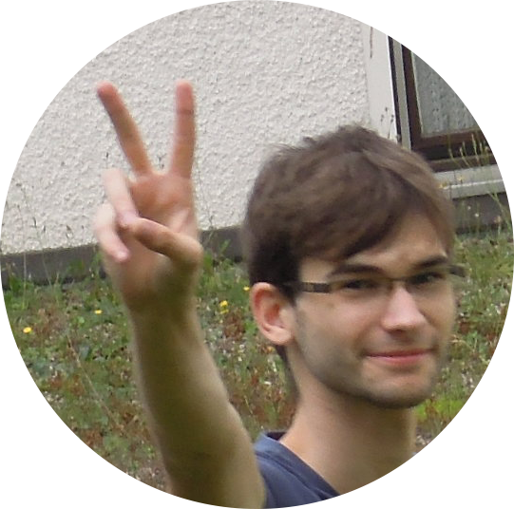

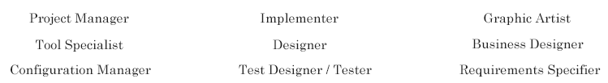
The LearningTriangle-Team
Steven Kovacs Marco Müller
→ We use RUP
Notes:
explain RUP: Rational Unified Process
from IBM (well known system for business to give different roles to persons)

Slide 4
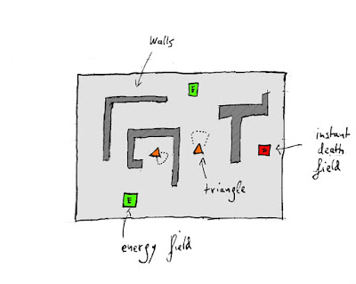
Short view on the Game rules
Creatures are triangles and they want to survive
each triangle has energy
no energy means death
special field types influence the triangle
the AI has to manage the game and walk as much distance as possible
Notes:
triangles want to live
explain the fields
explain the triangle abilities

Slide 5
Defining SRS and our Use Cases
important things in a Software Architecture Document are the Scope and the Use Case Diagram
Notes:
it also contains
specific requirements
functionality
usablility
design constraints (MVC)

Slide 6
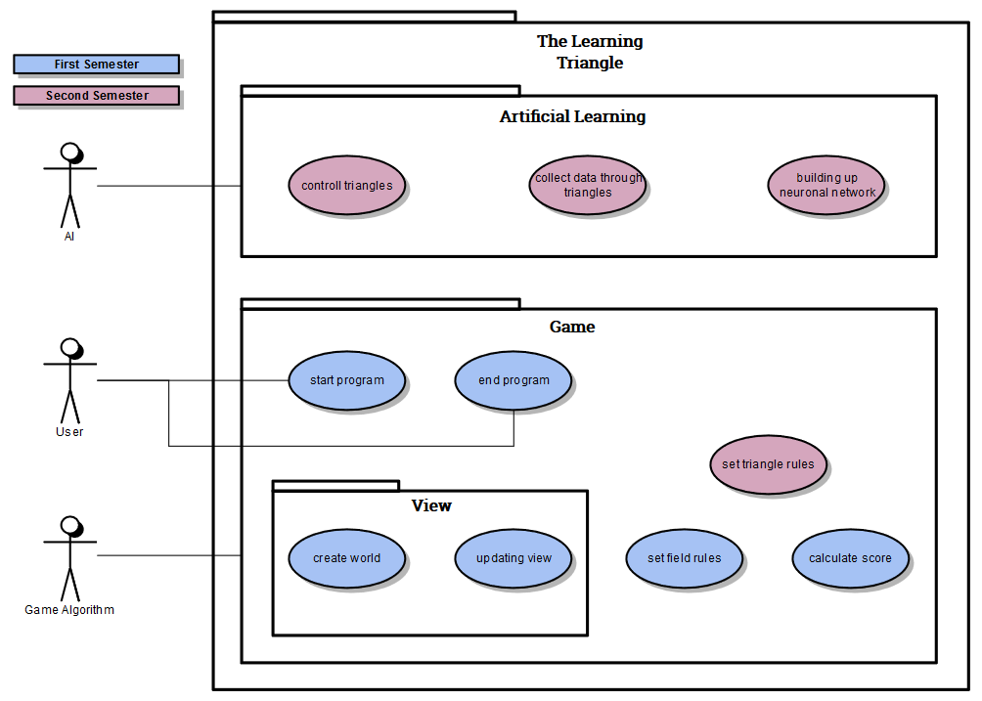
Notes:
explain scope and the idea behind the Use Cases

Slide 7
The way we develop
We followed the idea of an agile project
→ you have to welcome a change while you are working on your project
more contact with customer to follow his wishes
→ don’t develop over some years just to realize at the end that the customer wanted a program completely different

Slide 8


Things to do before programming
→ Project Management
Two main tools for us to be organized and follow the agile process:
Jira and Github
Notes:
explain why git is good
everything everytime up to date
don’t lose code when your computer dies
Our git
https://github.com/Noixes/thelearningtriangle

Slide 9
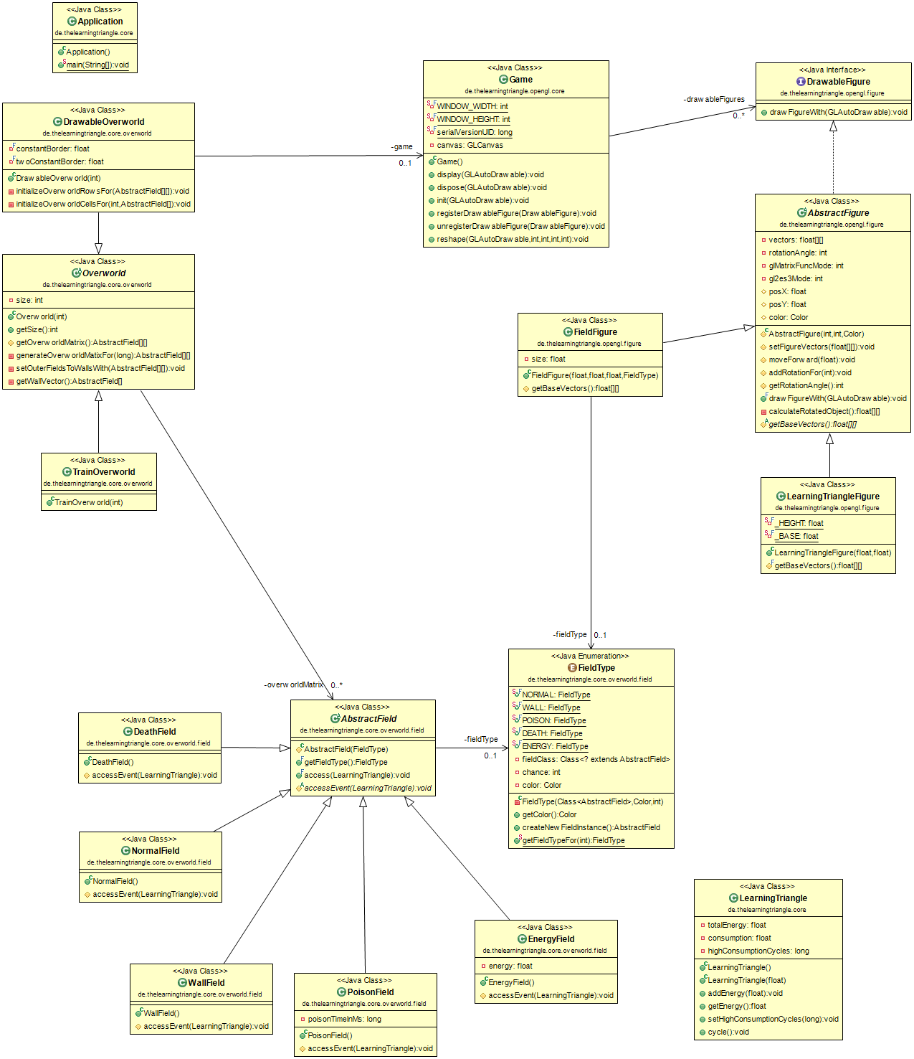
Our class diagram
We followed the MVC - Pattern, which means for us:
Model contains the data
Controller contains the algorithms
View contains the methods for showing the UI
We splitted the class diagram in these three parts

Slide 10
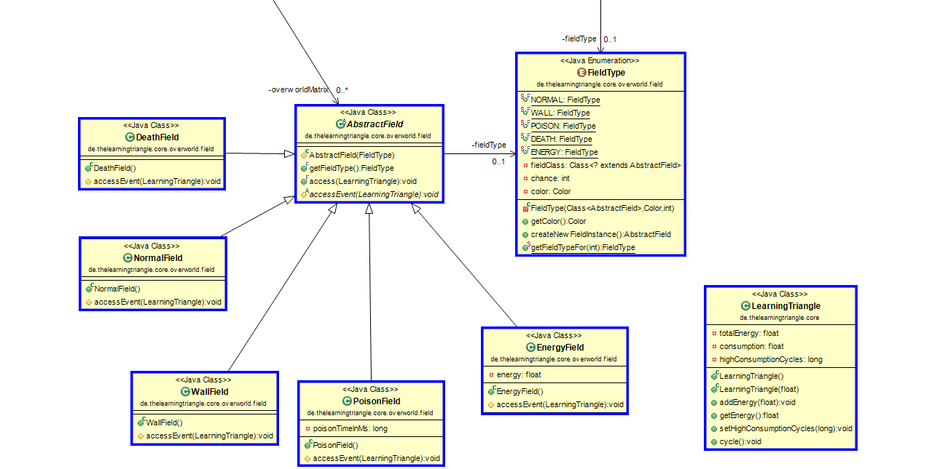
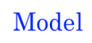

Slide 12


Slide 13
Our functionality
start/end game are just there to show the minimal user interaction
create world (random)
updating view
set field rules
calculate score
Notes:
explain scope and the idea behind the Use Cases

Slide 14
Use Case - Set field rules
activity diagram

Slide 15
Feature: Game rules
In order to set the game rules
As a triangle
I want to define the events for the different types of fields in the overworld
Scenario: Normal Field
Given I want to move in any direction
When I would move on a normal field
Then I move forward
Scenario: Poison Field
Given I want to move in any direction
When I would move on a poison field
Then I move forward
And my energy consumption becomes higher
Scenario: Energy Field
Given I want to move in any direction
When I would move on an energy field
Then I move forward
And my energy becomes higher
Scenario: Wall Field
Given I want to move in any direction
When I would move on a poison field
Then I don't move forward
Scenario: Death Field
Given I want to move in any direction
When I would move on a death field
Then I don't move forward
And I die
Notes:
just a short view

Slide 16

Testing the functionalities
we wrote .feature files, but they aren’t our way to test
→ we use the Mocking-Framework Mockito
Notes:
Steven, please explain why we use mock ups instead of JUnit

Slide 17
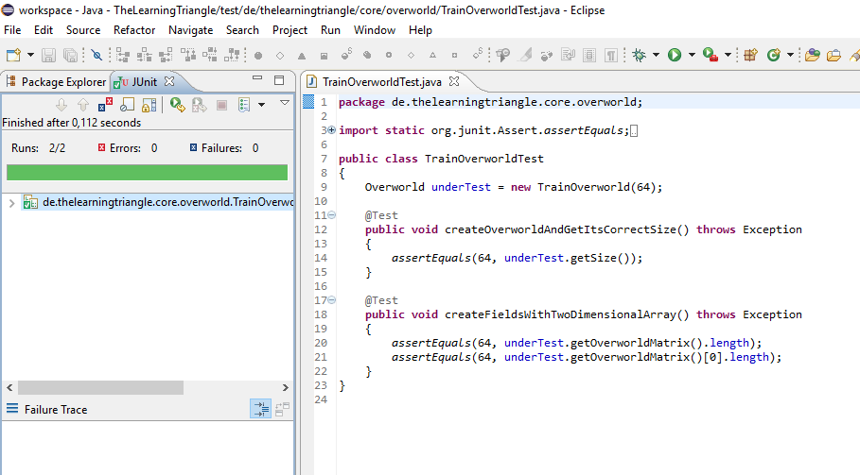
One example

Slide 18
Time spend

Slide 19
Finally, our demo of the program

